Slide 1
Industrial Barometer Q1 2026
IKEM | 2026 May 19

Slide 2
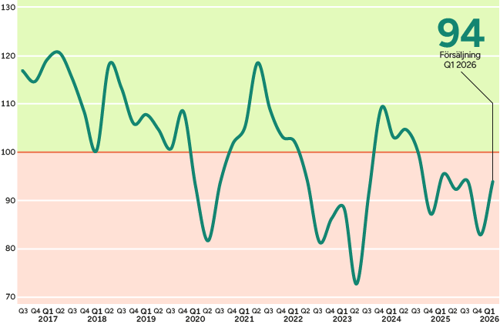
As expected, sales developed weakly
IKEM’s sales volume index came in at 94.
The result means that volumes are declining year-on-year, reflecting continued weak demand.
Differences between sub-sectors. Plastics, rubber and chemicals reported slightly increasing delivery volumes, while pharmaceuticals performed weaker.
IKEM index. Total sales development in the domestic and export markets for the period Q3 2016–Q1 2026.
Volume, year-on-year. Values above 100 indicate growth. Maximum value 150, minimum value 50. Source: IKEM.
Notes:
The first quarter of the year largely developed in line with the expectations companies themselves expressed in the previous Industrial Barometer. IKEM’s sales volume index came in at 94. Since 100 corresponds to unchanged development, this means that volumes are declining year-on-year, reflecting continued weak demand. Combined with rising costs, this risks holding back investments. Overall, the picture remains weak, though not uniformly so.
Compared with the fourth quarter of 2025, there are brighter signs. Plastics and rubber recorded an index of 107 and chemicals 108, indicating slightly increasing delivery volumes. This shows that parts of industry remain relatively strong. Pharmaceuticals, however, performed significantly weaker, with an index of 82. The fact that 79 percent state that the quarter ended in line with forecasts shows that the sales trend was not a surprise for many companies.
For industrial companies, this in itself is important. A weak but predictable market is easier to manage than rapidly falling and unpredictable demand

Slide 3
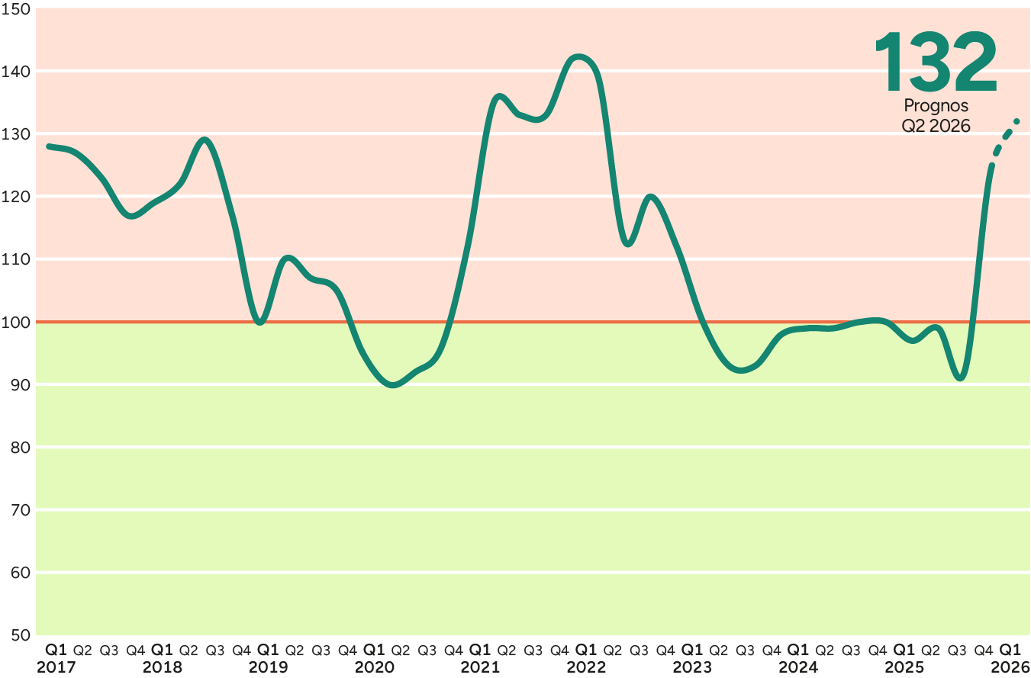
Soaring cost increases are the quarter’s major event
The most significant change during the quarter concerns the rapidly rising costs.
The war in the Middle East has driven up energy costs, particularly for oil and gas, but also for plastic raw materials and other oil-related raw materials and production inputs.
Companies have reported that:
  The costs of raw materials and production inputs increased by an average of 14 percent.
  Transport costs increased by 10 percent.
  Energy costs for operating production increased by 11 percent.
IKEM index for the cost of raw materials and production inputs. Year-on-year. Values above 100 indicate rising costs.
Maximum value 150, minimum value 50. Source: IKEM.
Notes:
The most significant change during the quarter concerns the rapidly and broadly rising costs. Sales volumes were weak, but did not deviate dramatically from forecasts. What stands out instead is the rising costs affecting companies across the board. This is taking place in an environment of weak demand, which, combined with rising costs, is putting pressure on companies.
The war in the Middle East has driven up energy costs, particularly for oil and gas, but also for plastic raw materials and other oil-related raw materials and production inputs. For companies within Swedish chemical and pharmaceutical production, this marked a clear shift.
Before 28 February, the cost situation was characterized by deflation. After that, developments turned quickly, with sharply rising costs. This is reflected, among other things, in the IKEM index for raw materials and production inputs, which now stands at 132, compared with an index of 92 in Q4 2025

Slide 4
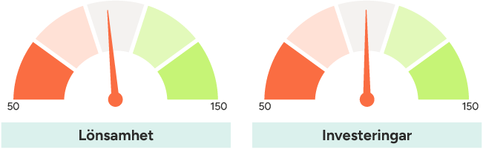
Lower profitability than last year
All sub-sectors also reported slightly lower profitability in the first quarter compared with last year.
Many companies are delivering under previously signed contracts and fixed-term agreements. In the short term, they are bound by previously agreed prices while production costs continue to rise. This is putting pressure on profitability across the entire industry.
EBIT margin Q1 2026: 95
Index 100 = neutral development, year-on-year.
Min: 50, max 150. Source: IKEM.
Investments Q1 2026: 100
Index 100 = neutral development, year-on-year.
Min: 50, max 150. Source: IKEM.
Notes:
With the substantial cost increases during the quarter, it is not surprising that all sub-sectors also reported slightly lower profitability in the first quarter compared with last year. Companies are unable to pass on cost increases to customers at the same pace. In addition, many companies are delivering under previously signed contracts and fixed-term agreements. This means that, in the short term, they are bound by previously agreed prices while production costs continue to rise. Taken together, this is putting pressure on profitability across the entire industry, even for companies that may be able to adjust their prices over the longer term.

Slide 5
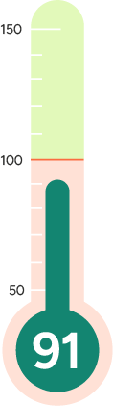
Forecast for Q2 still points to declining sales volumes
The forecast for the second quarter - all sectors expect volume declines in Q2, with the exception of the rubber and plastics industry, which forecasts increasing sales volumes.
Many companies express considerable uncertainty regarding future market conditions.
IKEM companies expect a slight decline in volumes for the full year 2026.
Forecast for future sales, 3 months
Companies’ Q1 forecast for total sales volumes (domestic market and exports) stands at 91.
Index 100 = neutral development, volume year-on-year. Source: IKEM.
Notes:
The forecast for the second quarter, all sectors expect volume declines in Q2, with the exception of the rubber and plastics industry, which forecasts increasing sales volumes. A very large number of companies express significant uncertainty regarding future market conditions among both customers and suppliers, as well as concerns about both the availability and pricing of specific raw materials and production inputs.
Making longer-term forecasts in the current global environment is extremely difficult, but IKEM companies expect a slight decline in volumes for the full year 2026. There is a relatively wide spread in how companies view their sales prospects. Just under 30 percent of companies expect volume growth of varying degrees, while just under 60 percent expect volume declines of varying degrees for the year as a whole.

Slide 6
About IKEM:s Industrial Barometer
IKEM’s Industrial Barometer is based on a recurring quarterly survey of member companies. The chemical, plastics and rubber industries are energy‑intensive and sensitive to economic cycles. Positioned early in the value chain, they manufacture intermediate goods for the rest of the industrial sector. As a result, shifts in macroeconomic conditions tend to be felt early by companies in these industries.
The Industrial Barometer is compiled by IKEM’s Chief Economist, Carl Eckerdal. The barometer has tracked developments since 2016 and is published quarterly.
The data for this report was collected between 5 January and 5 February 2026 and is based on responses from 120 companies with a combined turnover of SEK 450 billion in 2025, corresponding to approximately 74 percent of the industry’s total turnover. All responses are weighted according to company turnover. Total development is weighted by each sub‑industry’s share of total value added in the previous financial year.
Do you have questions about the Industrial Barometer? Please contact Carl Eckerdal, Chief Economist, at carl.eckerdal@ikem.se or +46 (0)70‑497 11 98.

