Slide 1
Industrial Barometer
Q2 2026
IKEM | August 2026

Slide 2
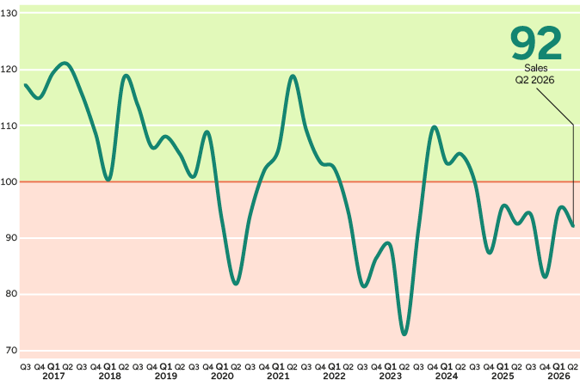
The plastics industry goes against the tide
– but the overall picture remains weak
IKEM’s delivery index came in at 92, which means lower volumes at annual rate.
The picture is divided: plastics/rubber increased clearly, with an index of 121.
Pharmaceuticals (77) and chemicals/refining (83) held back the overall picture.
IKEM index. Overall sales trend on the domestic and export markets for the period Q3 2016–Q2 2026.
Volume at annual rate. Values above 100 indicate growth. Maximum value 150, minimum value 50. Source: IKEM
Notes:
Let us start with the overall picture. The IKEM industry continued to develop weakly during the second quarter. The delivery index came in at 92 and, since 100 means unchanged, that means lower volumes than a year ago. This was broadly what the member companies themselves anticipated in last quarter’s barometer.
But the total figure is only half the story. Behind it lies a divided picture. Plastics and rubber are going against the tide with an index of 121 – a clear increase in volume. Chemicals and refining stand at 83 and pharmaceuticals at 77. It is these last two that are pulling the overall figure down.
Why does it look like this? For pharmaceuticals, much points to structural factors rather than the business cycle – but the barometer does not give us the answer. For plastics, chemicals and refining the link to the business cycle is clearer, even though they moved in different directions during the quarter. So the business cycle explains only part of it. Worth mentioning: 74 per cent of the companies felt the quarter turned out as expected. The plastics industry is the exception – there, 64 per cent said it went better than they had thought. That is the quarter’s positive surprise.

Slide 3
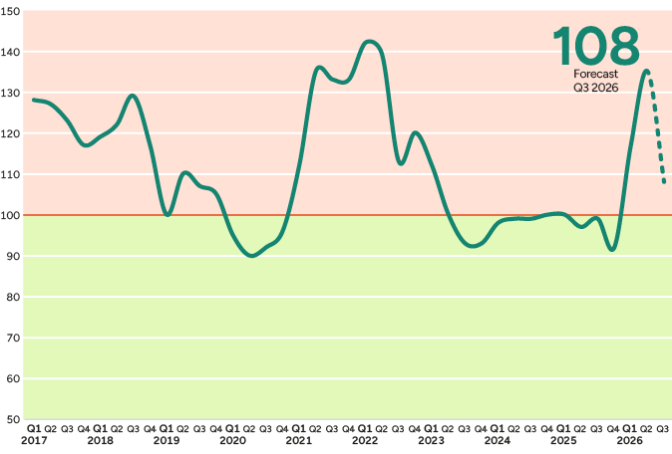
Cost pressure persists
– but the outlook is brighter
Production costs continued to rise broadly during Q2.
At overall level, the index for raw materials and inputs came to 135, energy to 129 and transport to 128.
Ahead of Q3, the forecast for raw materials and inputs points down to 108 – costs are still rising, but at a more cautious rate.
IKEM index of the cost of raw materials and inputs. Annual rate. A value above 100 indicates rising costs.
Maximum value 150, minimum value 50. Source: IKEM
Notes:
Turning to costs, where the picture is unambiguous. The energy-driven cost inflation triggered by the war in the Middle East became even clearer during Q2, and it hit every sub-sector.
At overall level, raw materials and inputs came in at 135, energy at 129 and transport at 128. The hardest pressure was faced by chemicals and refining, with a raw materials index of 147.
But look at the curve on the far right – the forecast for Q3 looks considerably brighter. After a period of a more stable crude oil price, the raw materials index is expected to fall to 108. So costs are still rising, but at a much more cautious rate. The important caveat is that the forecast is highly uncertain; energy prices depend directly on how the conflict in the Middle East develops.

Slide 4
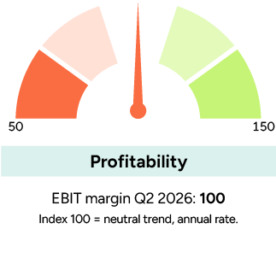
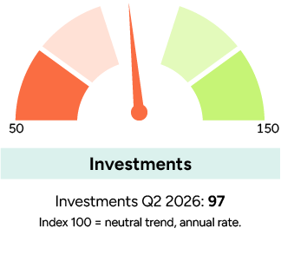
Profitability is unchanged – but the differences are large
The overall profitability index stood at 100, that is to say an unchanged level of profitability at annual rate.
Chemicals and refining as well as plastics/rubber reported stronger profitability, while pharmaceuticals fell clearly.
Investments at overall level were just below neutral level, at an index of 97.
Index 100 = neutral trend, annual rate. Maximum value 150, minimum value 50. Source: IKEM
Notes:
Here is perhaps the quarter’s most surprising figure. Despite costs soaring during Q2, the overall profitability index came in at exactly 100 – in other words, unchanged profitability compared with a year ago. Companies have simply managed to pass the costs on, or to compensate in other ways.
But the total figure conceals large differences. Chemicals and refining faced by far the hardest cost pressure – raw materials up to an index of 147 – and still strengthened profitability to 119. Plastics and rubber stand at 110. Pharmaceuticals pull in the other direction, at 77. Look at investment too: an index of 97, just below neutral level. Plastics and rubber are investing more than last year at 109, while chemicals and refining are holding back at 89. That says something about where confidence in the future lies right now. In summary: profitability is standing still on the surface, but beneath it the sub-sectors are moving in different directions. And since the cost forecast is brightening ahead of Q3, there is a possible bright spot here – if volumes turn.
Figure 2. IKEM index broken down by sub-sector. Q2 2026. Index 100 corresponds to neutral trend, annual rate. Values below 100 represent a decline. Total deliveries (volume) Number of employees Investments Costs of raw materials/inputs Energy costs (gas/electricity) Transport costs Company profitability (EBIT margin). Plastics/rubber 121 102 109 134 120 124 110. Pharmaceuticals 77 77 100 124 123 124 77. Chemicals/refining 83 89 89 147 136 127 119. Total 92 86 97 135 129 128 100.

Slide 5
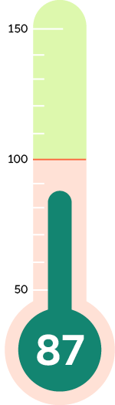
Companies expect a weak Q3
The forecast once again points to declining production volumes, with a forecast index of 87.
Plastics/rubber expect unchanged production, while pharmaceuticals and chemicals/refining see a continued decline.
At the same time, companies judge that the rise in costs will slow during Q3.
The companies’ forecast for total sales volume (domestic market and exports) comes to 87.
Index 100 = neutral trend, volume at annual rate. Maximum value 150, minimum value 50. Source: IKEM
Notes:
We will finish by looking ahead. The cautious optimism we could sense during Q2, above all in the plastics and rubber industry, does not hold when companies look towards the third quarter.
The forecast index comes in at 87 – in other words, clearly declining production volumes. Plastics and rubber expect unchanged production after the strong quarter, chemicals and refining stand at 86 and pharmaceuticals at 77. So no sub-sector is forecasting growth.
There is nevertheless some relief on the cost side. Prices of raw materials and inputs are expected to go from 135 down towards 108, and energy prices towards 112. So costs are still rising, but at a distinctly calmer pace. The reservation is that this picture depends on how the conflict in the Middle East develops. Employment is also expected to soften, with an index of 86. The conclusion I want to leave you with is gradual stabilisation rather than a rapid turnaround – a clearer recovery probably lies in early 2027. I am happy to take questions now.
Figure 6. Measured at annual rate, what is the company’s forecast for the next 3 months with regard to production (volume), number of employees and purchase prices? Forecast for Q3 2026. Index 100 corresponds to unchanged level (annual rate). Maximum value 150, minimum value 50. Source: IKEM. Production (volume) Number of employees Energy prices (gas/electricity) Prices of raw materials/inputs. Plastics/rubber 100 102 95 92. Pharmaceuticals 77 77 123 123. Chemicals/refining 86 87 104 94. IKEM total 87 86 112 108.

Slide 6
About IKEM’s Industrial Barometer
IKEM’s Industrial Barometer is based on a recurring quarterly survey of member companies. The chemicals, plastics and rubber industries are energy-intensive and cyclical sub-sectors that are positioned early in the value chain. The Industrial Barometer is compiled by IKEM’s chief economist Carl Eckerdal and has tracked developments since 2016.
The data were collected 2 July–10 August 2026 and are based on 125 industrial companies. Together, they recorded turnover of SEK 480 billion in 2025, corresponding to around 74 per cent of the sector’s total turnover. The responses are weighted by company turnover and total developments by the sub-sectors’ share of value added.
Questions? Contact Carl Eckerdal: carl.eckerdal@ikem.se or +46 70-497 11 98.

