Slide 1
IKEMS:s Industrial Barometer Q4 2025
February 2026

Slide 2
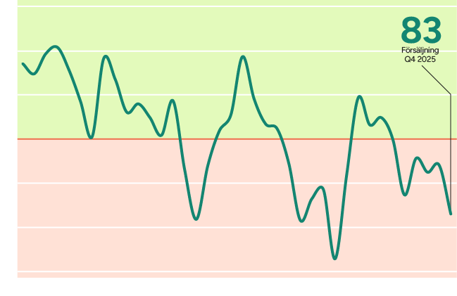
IKEM industries remain in recession
An IKEM index value of 83 signals a clear decline in volume.
The forecast in the previous quarter’s Industrial Barometer was 87, slightly above the now‑confirmed outcome.”
Source: IKEM:s Industrial Barometer Q4 2025
Notes:
An IKEM index value of 83 indicates a clear decline in volume (with 100 representing unchanged development). Expectations ahead of the fourth quarter were already low; the forecast in the previous quarter’s Industrial Barometer was 87, slightly above the now‑confirmed outcome.

Slide 3
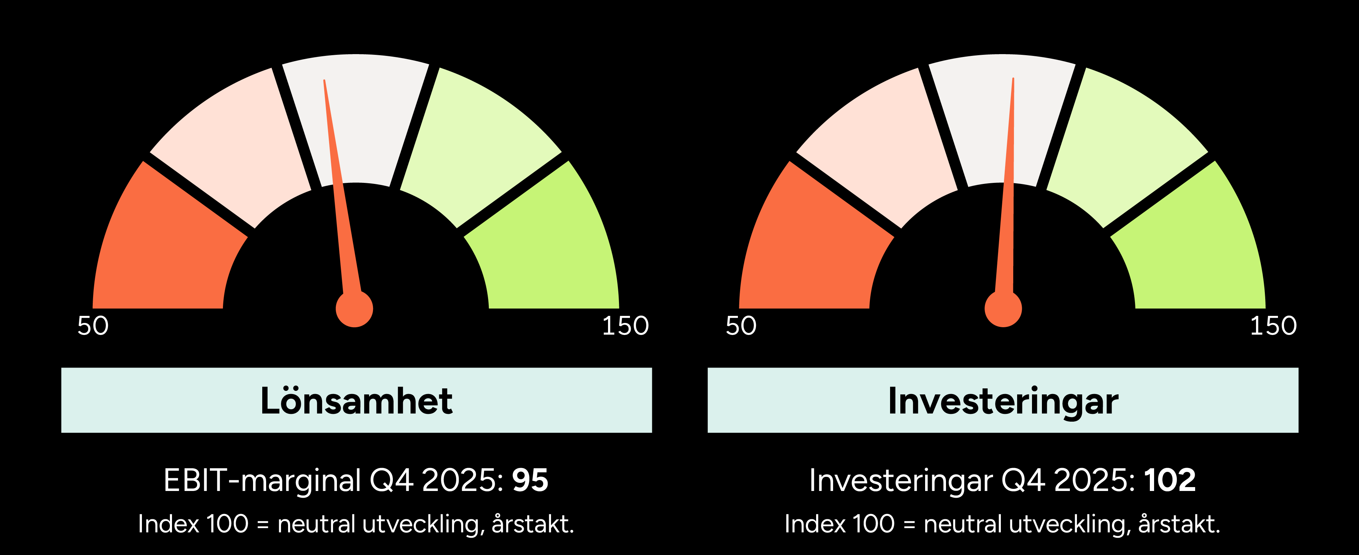
Weak economic conditions are negatively affecting profitability and investments
Source: IKEM:s Industrial Barometer Q4 2025
Notes:
Sweden’s chemical, plastics/rubber, and pharmaceutical industries ended the fourth quarter of 2025 with declining volumes, and the total value of the IKEM Index landed at 83, clearly signalling a continued economic downturn. Profitability came under pressure, particularly in plastics/rubber, due to higher energy costs and currency fluctuations. Despite this, many companies see some potential, for example through projected volume increases in chemicals (108) and plastics/rubber (105) in the forecast for the first quarter of 2026. External factors—such as rising import volumes from China and unpredictable tariff policies in the United States—continue to pose risks for EU industrial companies. Investments in defence and infrastructure within the EU may provide a boost to the economic cycle, with a positive impact on Swedish industry.

Slide 4
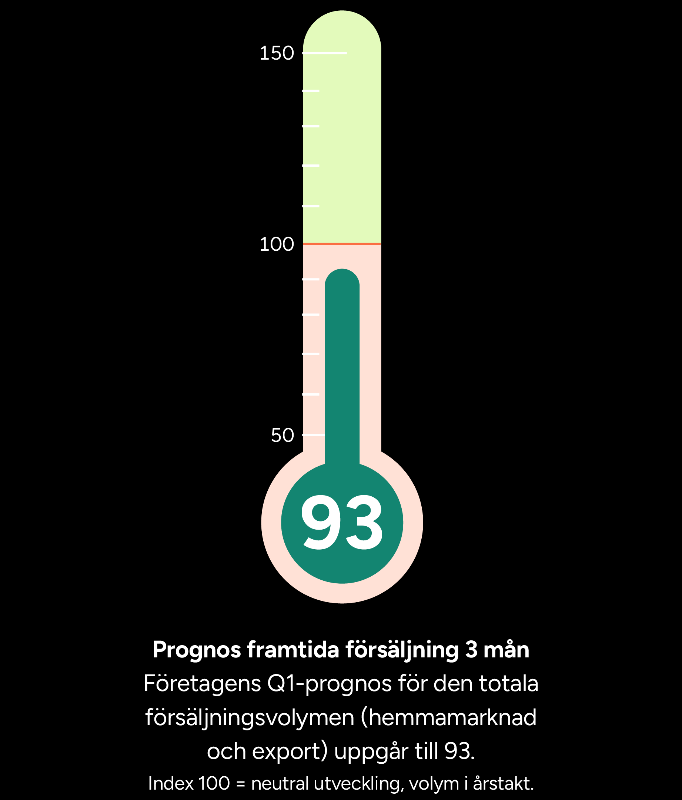
The forecast for Q1 2026 indicates continued weak sales growth
The Industrial Barometer (93) points to continued weak sales volumes, although the chemical and plastics/rubber industries show some growth.
Germany is showing signs of gradual recovery, which is important for the industrial countries of Northern Europe.
IMF estimates that the Eurozone will grow by 1.3% in 2026, while Sweden is expected to reach around 3%, driven primarily by domestic demand.
Source: IKEM:s Industrial Barometer Q4 2025
Notes:
The Swedish industrial economy showed few signs of recovery during the final quarter of 2025. On the contrary, industrial companies in most sectors represented by IKEM continued to experience declining sales volumes (year‑on‑year). The forecast value of 93 indicates continued decreases in sales volumes. Excluding the expected decline in the pharmaceutical industry, however, the picture is somewhat brighter: the chemical industry (108) and the plastics/rubber industry (105) signal increasing sales volumes. Still, these shifts should be seen as minor fluctuations rather than signs of an imminent upswing — the long‑awaited economic recovery has yet to materialise.
There is, however, some hope of a cyclical shift. The Ifo Business Climate Index for German industry is gradually improving. Since Germany is a central engine of the EU internal market, even modest improvements have implications for industrial nations in Northern Europe. Additionally, increased investments in defence and infrastructure across the EU may act as catalysts for European growth. A recent economic outlook from the IMF also indicates an economic awakening in Germany in 2026, along with expectations that the economy of the Eurozone as a whole will grow by 1.3 percent. The consensus forecast for the Swedish economy of 3 percent stands out in a European context, largely driven by domestically fueled growth following substantial fiscal stimulus measures implemented this year.”

Slide 5
About IKEM:s Industrial Barometer
IKEM’s Industrial Barometer is based on a recurring quarterly survey of member companies. The chemical, plastics and rubber industries are energy‑intensive and sensitive to economic cycles. Positioned early in the value chain, they manufacture intermediate goods for the rest of the industrial sector. As a result, shifts in macroeconomic conditions tend to be felt early by companies in these industries. The Industrial Barometer is compiled by IKEM’s Chief Economist, Carl Eckerdal. The barometer has tracked developments since 2016 and is published quarterly.
The data for this report was collected between 5 January and 5 February 2026 and is based on responses from 120 companies with a combined turnover of SEK 450 billion in 2025, corresponding to approximately 74 percent of the industry’s total turnover. All responses are weighted according to company turnover. Total development is weighted by each sub‑industry’s share of total value added in the previous financial year.
Do you have questions about the Industrial Barometer? Please contact Carl Eckerdal, Chief Economist, at carl.eckerdal@ikem.se or +46 (0)70‑497 11 98

